Slide 1






SunSafe
“Shining a Light on Energy Integrity”
Presented by Team Sunflower:
CTO - Annette Manntschke
COO - Tim Weiand
CHO - Utku Ozkan
Website
www.SunSafe.com

Slide 2
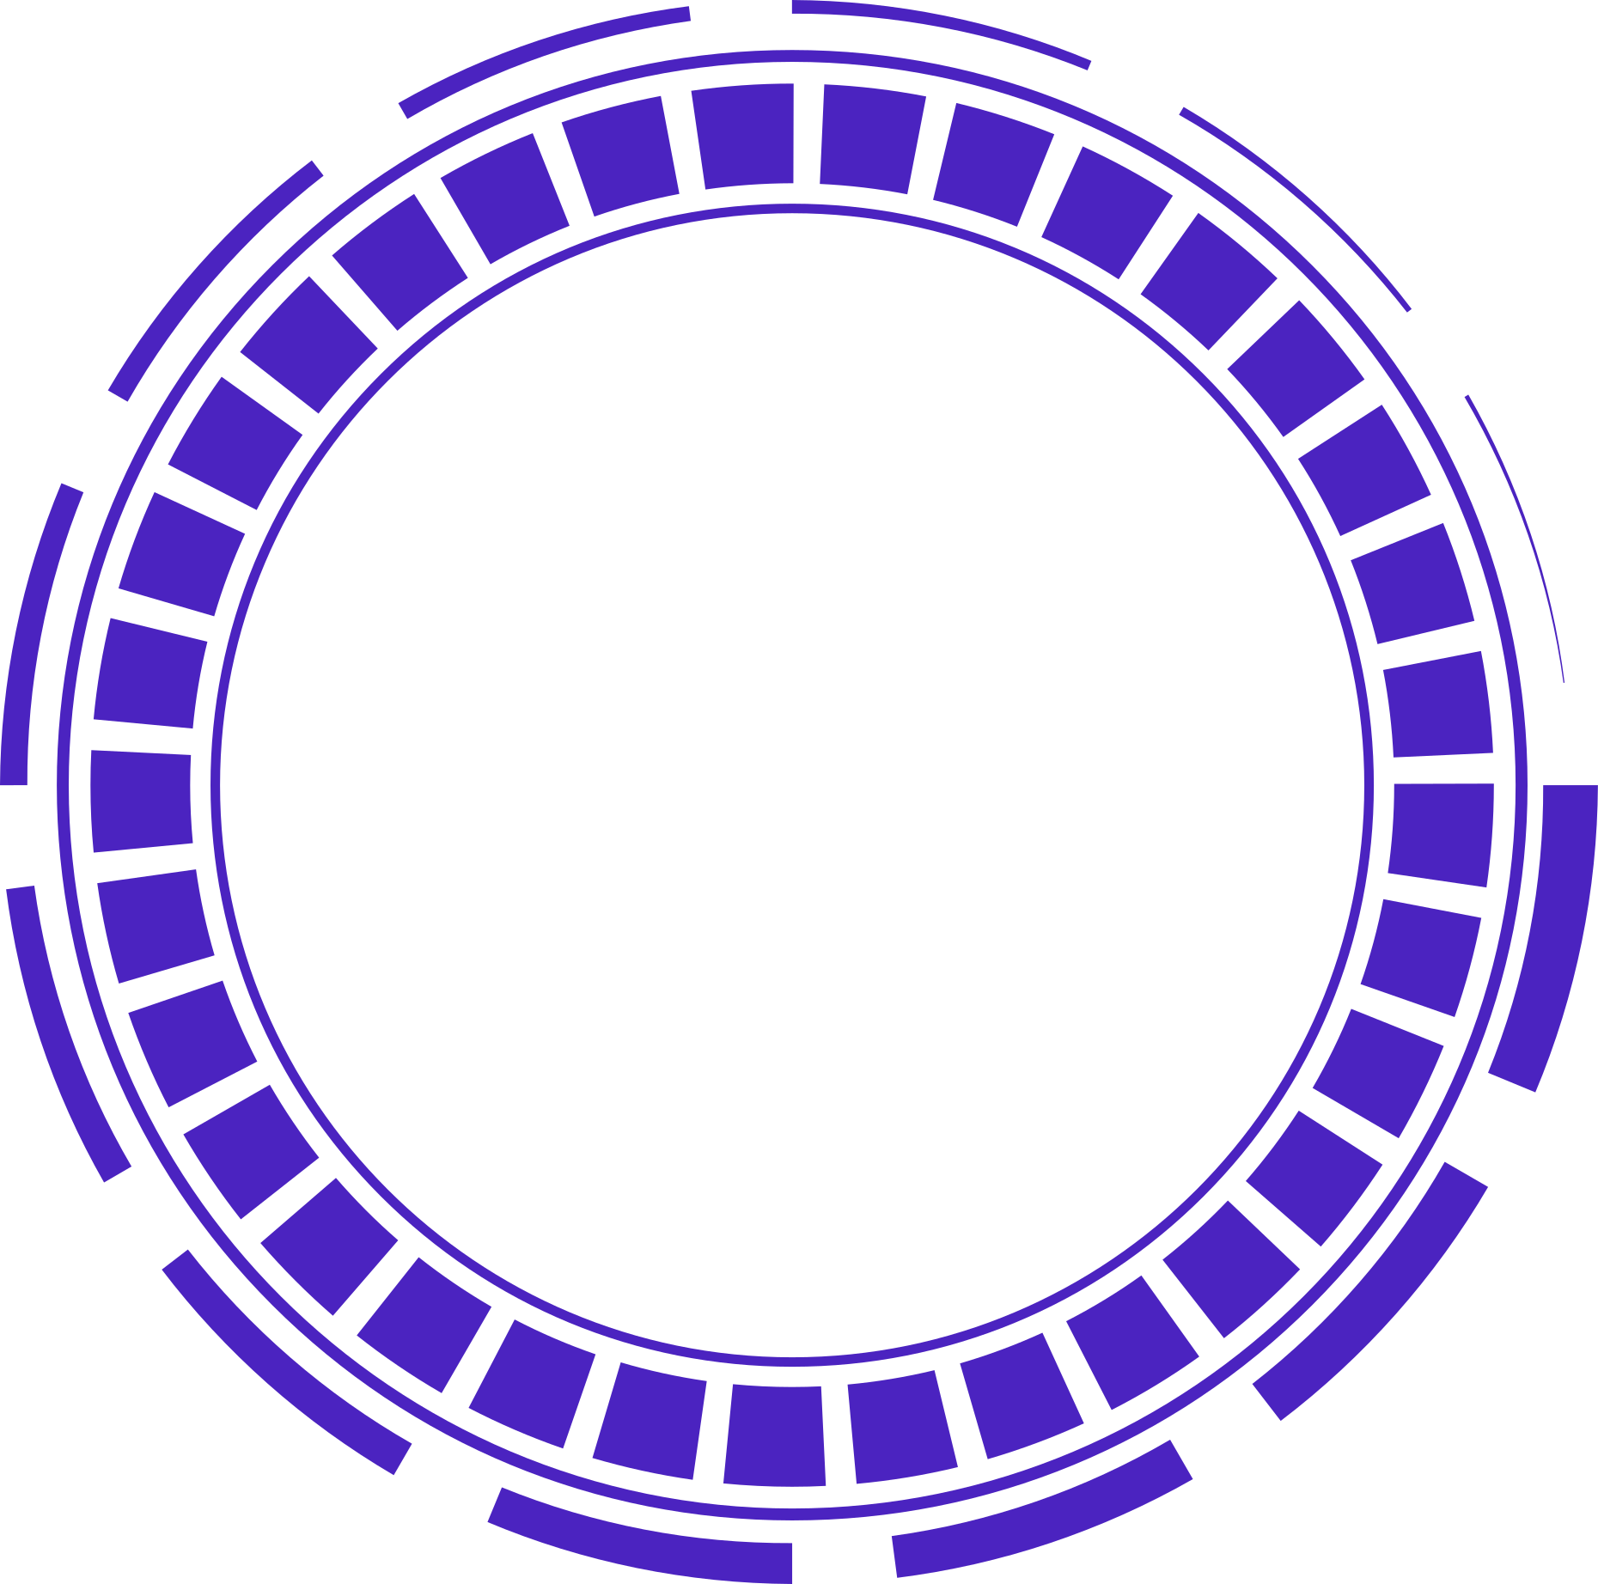

“Shining a Light on Energy Integrity”
SunSafe Sentinel
SunSafe specializes in cutting-edge AI-powered solutions for fraud detection. We help modern energy providers ensure security and efficiency.
Website
www.SunSafe.com

Slide 3

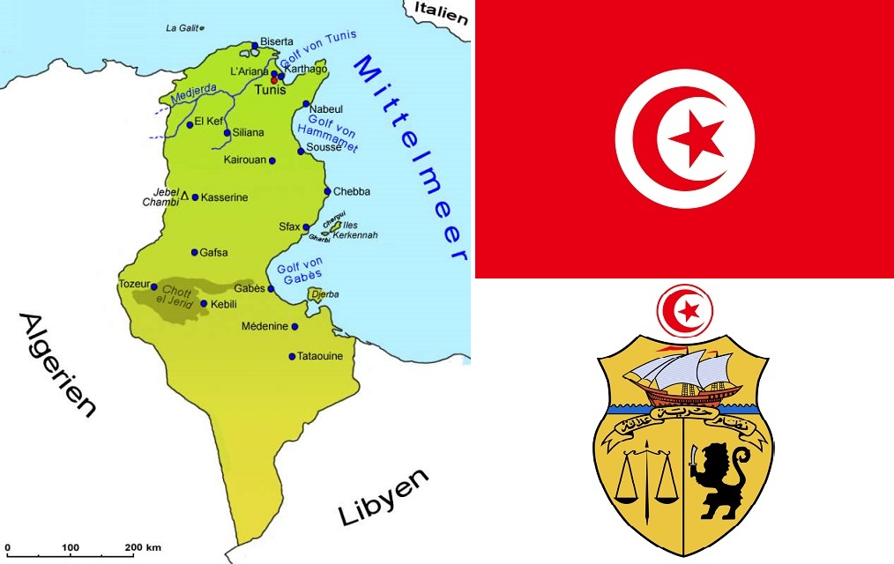

Mission
Custom models and updates
Statement
Revolutionary Two-stage AI model:
maximize fraud case detection using XGBoost
refinement of accuracy with a secondary layer
We provide our customers like Steg with an adaptable solution that flags fraud and categorizes risk levels
Fraud detection
Meter manipulations cost energy providers a lot of money: STEG (Société Tunisienne de l'Électricité et du Gaz) annually loses 300k Euros due to manipulations of meters.
We help ensuring fair and transparent energy consumption for all.
Leveraging advanced machine learning and data-driven insights is our specialty.
We empower utility companies to protect their revenue, enhance operational efficiency, and build a more sustainable energy future.

Slide 4
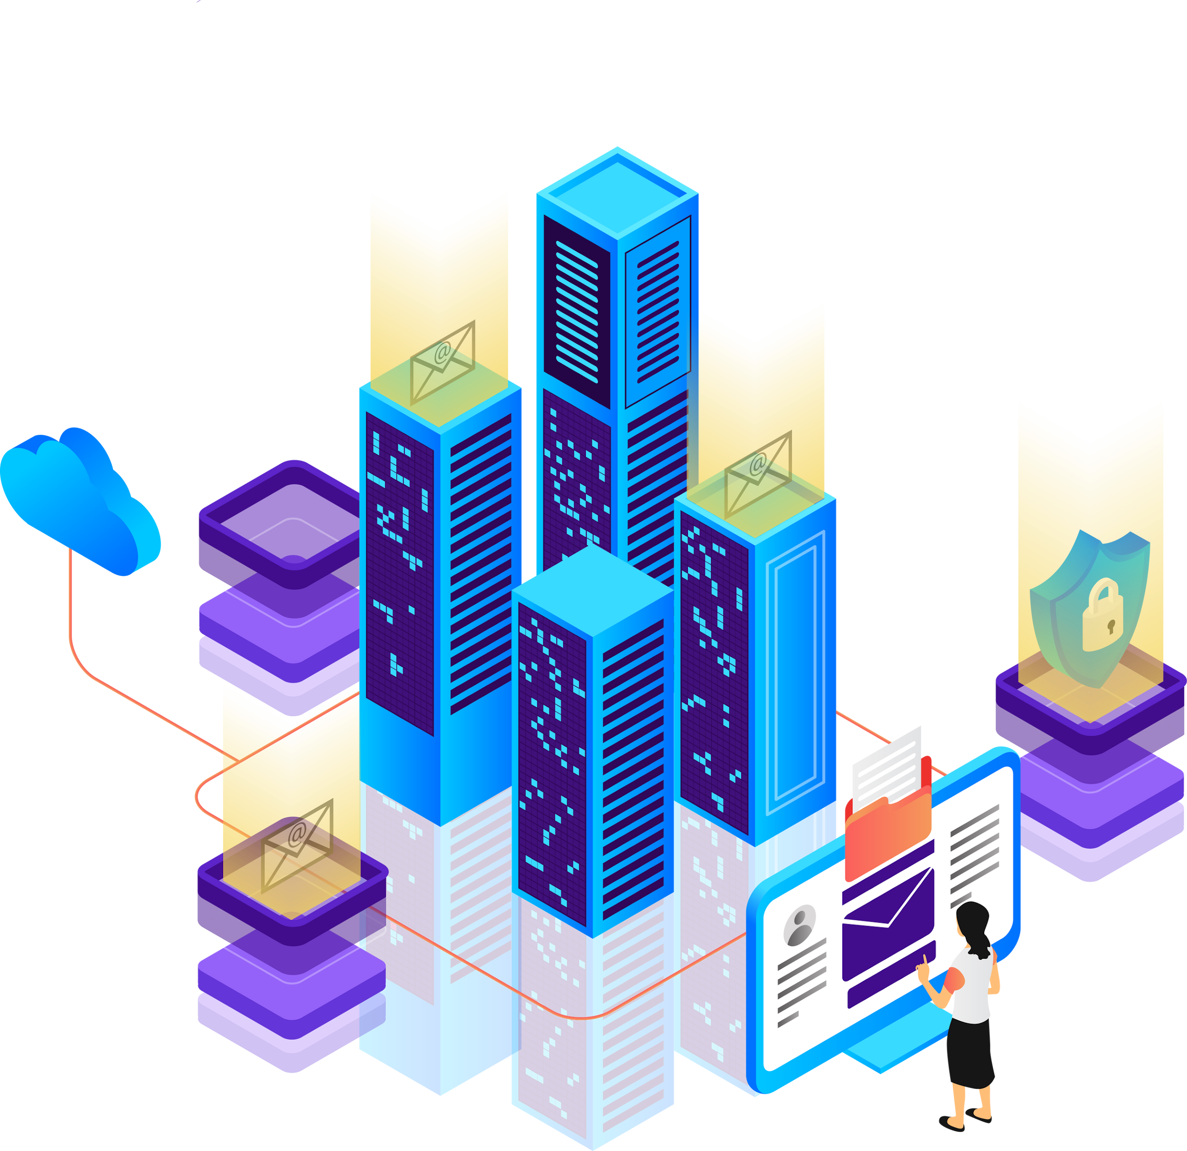


STEG client data EDA
Preprocessing
94%
Non- fraud
Clean, aggregated data from 2005 to 2018
unprocessed data
We refined the STEG data by cleaning inconsistencies and aggregated billing records per customer to construct a well structured dataset for our analysis.
Features for gas and electricity bills included: e.g. region, district, STEG consumption category of each client
We understood the class imbalance in the client data and later addressed it for accurate and reliable fraud detection
6%
Fraud
Notes:
test

Slide 5
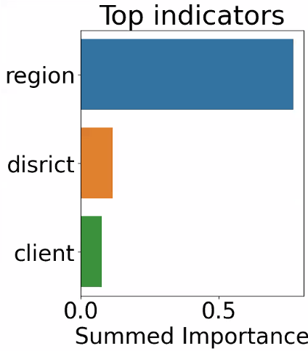

Layered
ML model
01
Preprocessing
02
XGBOOST layer
03
2nd Layer
Imbalance: assigned more weight to fraud cases
Imputing: missing values
Encoding: categorical features
fast
no scaling
good generalization
rank feature impact
optimized for finding all fraud cases
trained on output of first stage
optimized for eliminating false positives
including categorization into risk levels with adjustable thresholds

Slide 6
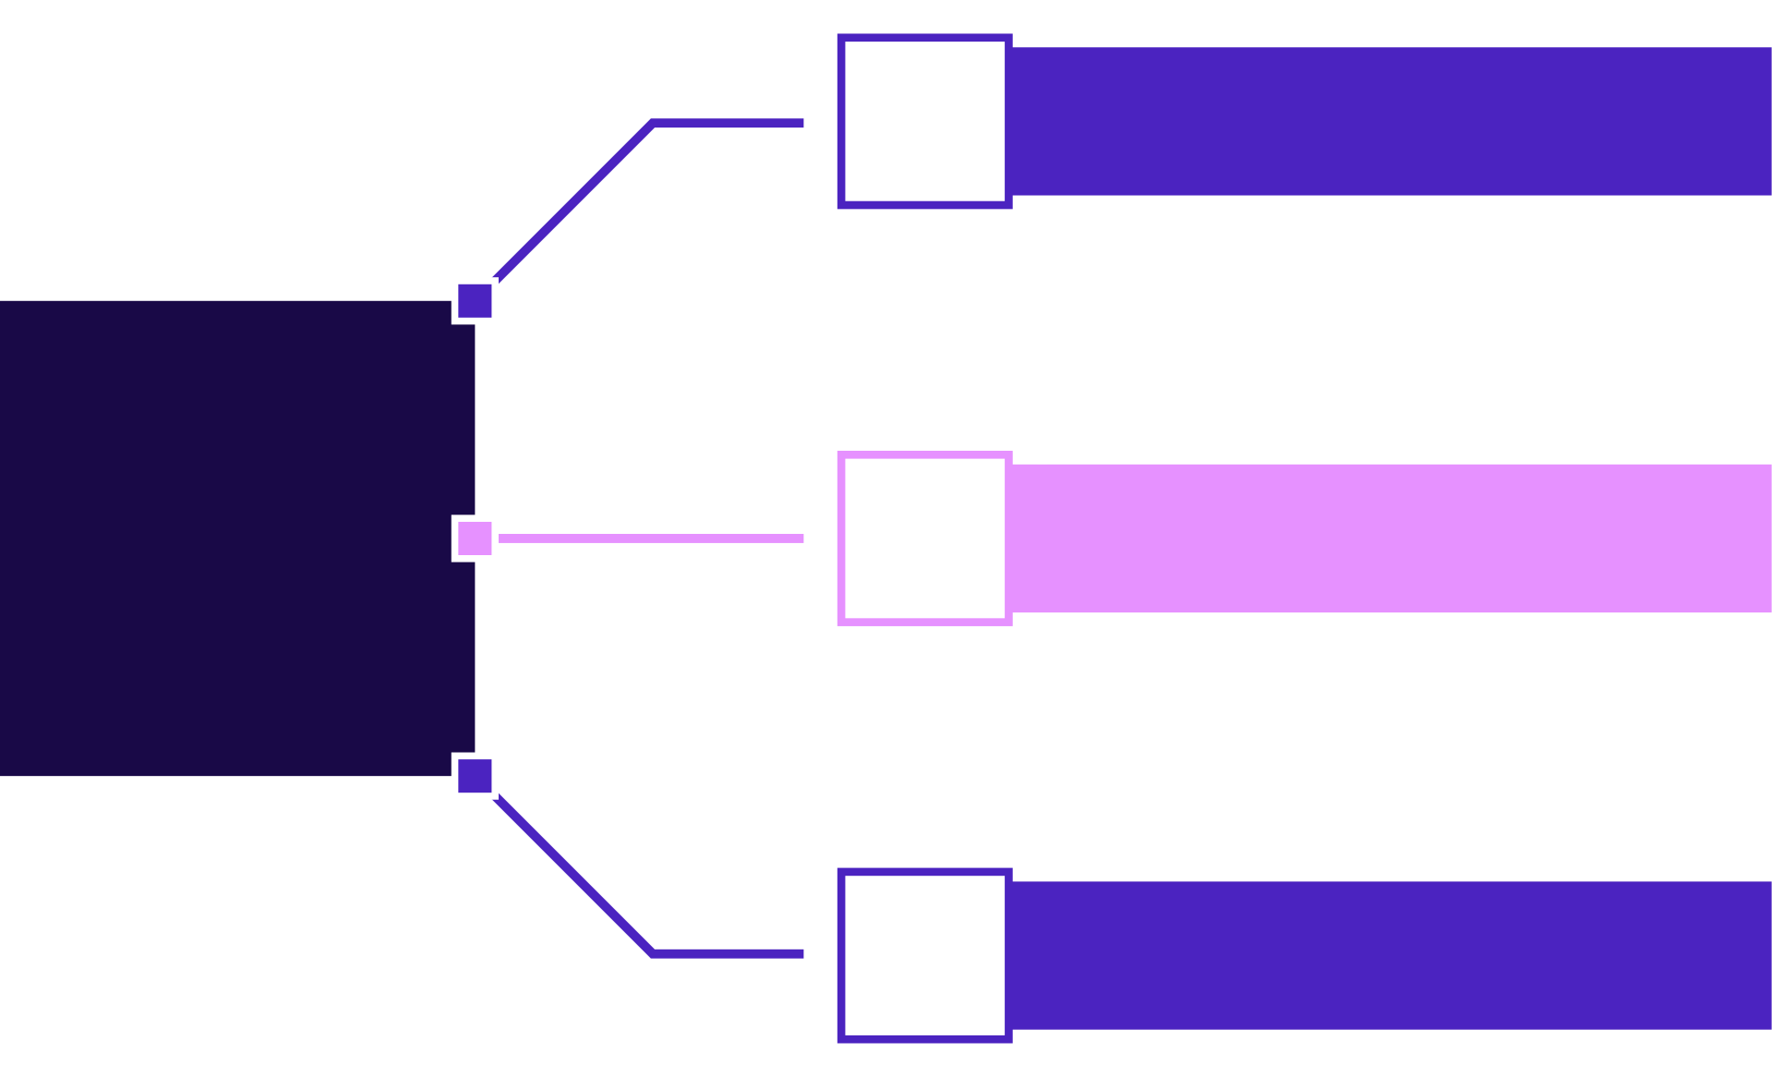
What we provide for STEG: Customized Solution!
Three level system: provides flexible human verification workload
Categorizing Risk Levels
01
High Risk
Sentinel
Risk
Assessor™
Raw Data
02
Medium Risk
03
Low Risk

Slide 7

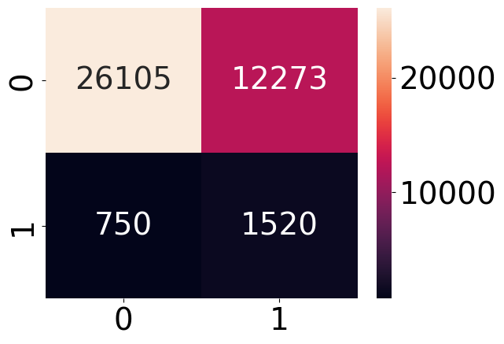
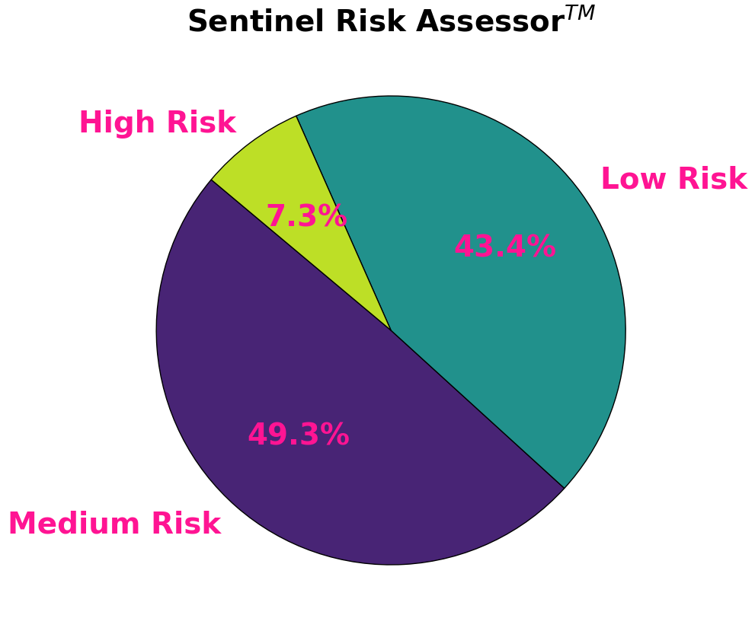
Model
Performance
Our Model identifies a non-negligible proportion of Fraud!
STEG will be able to tap into loss-prevention by revealing fraudulent customers
Potential recovered funds: 200.890 Euros per year.
01
Threshold 1: 30%
flag and only use suspicious cases as 2nd layer input
Fraud
02
Threshold 2: bins
0 - 40% : Low Risk
41 - 70% : Medium Risk
71 - 100% : High risk
03

Slide 8

Time series
with tsfresh package
SunSafe
Outlook
Feature Engineering
For STEG we have even more products and hold a variety of subscription plans ready!
We tailor and scale our models and services according to your needs.
Ensemble methods
Optimized Data-Driven Fraud detection

Slide 9


Thank You!
SunSafe Repository
Data Source on Zindi
Get in touch with us
Presented by
Team Sunflower
Website
www.SunSafe.com
hi@SunSafe.com

Slide 10
Feedback
Feature engineering: frequency of invoice_date ( count) in aggregation
XGBoost does not need any feature encoding ( despite being tree based, it's a different package. scikit-learn needs encoding, xgboost not)
Business goal 2. highlight and stick to metric of choice for all models

